Slide 1
Qualitative Data Analysis and Interpretation

Slide 2
Data analysis
  An attempt by the researcher to summarize collected data.
Data Interpretation
  Attempt to find meaning
How do these differ by research tradition?
  Quantitative
  Qualitative

Slide 3
Data Analysis During Collection
Analysis not left until the end
To avoid collecting data that are not important the researcher must ask:
  How am I going to make sense of this data?
As they collect data the researcher must ask
  Why do the participants act as they do?
  What does this focus mean?
  What else do I want to know?
  What new ideas have emerged?
  Is this new information?

Slide 4
Data Analysis After Collection
One way is to follow three iterative steps
  Become familiar with the data through
    Reading
    Memoing
  Exam the data in depth to provide detailed descriptions of the setting, participants, and activities.
  Categorizing and coding pieces of data and grouping them into themes.

Slide 5
Data Analysis After Collection Summarizing
“the first time you sit down with your data is the only time you come to that particular set fresh”-Kratowohl.
  Reading and memoing
    Read write memos about field notes.
  Describing
    Develop comprehensive descriptions of setting, participants, etc.
  Classifying
    Breaking data into analytic units.
    Categories
    Themes

Slide 6
Data Analysis Strategies
Identifying themes
  Begin with big picture and list “themes” that emerge.
    Events that keep repeating themselves
Coding qualitative data
  Reduce data to a manageable form
  Often done by writing notes on note cards and sorting into themes.
    Predetermined categories vs. emerging categories

Slide 7
How to make coding manageable
Make photocopies of original data
  Why?
Read through all of the data.
  Attach working labels to blocks of text
Cut and paste blocks of text onto index cards.
Group cards that have similar labels together
Revisit piles of cards to see if clusters still hold together.

Slide 8
Other Strategies
Concept Mapping
  Analyzing Antecedents and Consequences
  Displaying Findings
  Stating what’s missing
Illness
Social Skills
Absenteeism
School Safety

Slide 9
Data Interpretation
Answer these four questions
  What is important in the data?
  Why is it important?
  What can be learned from it?
  So what?
Remember
  Interpretation depends on the perspective of the researcher.
    Why?

Slide 10
Interpretation
One technique for data interpretation (Wolcott)
  Extend the analysis by raising questions
  Connect findings to personal experiences
  Seek the advice of “critical” friends.
  Contextualize findings in the research
    Converging evidence?
  Turn to theory

Slide 11
Ensuring Credibility
Are the data based on one’s own observation, or is it hearsay?
Is there corroboration by other’s of the observation?
In what circumstances was an observation made or reported?
How reliable are those providing the data?
What motivations might have influenced a participant’s report?
What biases might have influenced how an observation was made or reported?

Slide 12
Mixed Methods?
A combination of quantitative and qualitative techniques.
  Under what circumstances might mixed methods work?
  Under what circumstances might mixed methods not work?
    Think epistemological perspectives.

Slide 13
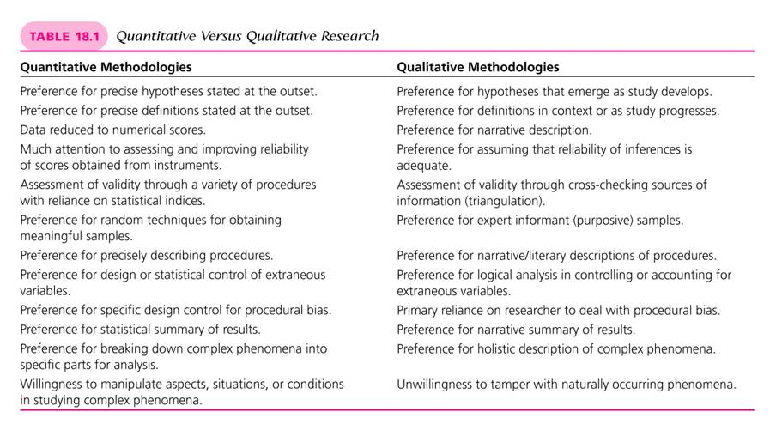
Quantitative vs. Qualitative

Slide 14
Definition and Purpose
Mixed methods research
  A style of research that uses procedures for conducting research that are typically applied in both quantitative and qualitative studies
  The purpose of these designs is to build upon the synergy and strength that exists between quantitative and qualitative methods in order to more fully understand a given phenomenon than is possible using either quantitative or qualitative methods alone

Slide 15
Definition and Purpose
Mixed methods research
  The research problem itself determines the choice of a design
  Examples:
    Using surveys to identify specific groups of students and conducting focus groups with them to understand their views
    A series of interviews are conducted to ascertain the critical issues bothering students, and a survey of the student body is conducted using these issues as variables

Slide 16
Three Types of Designs
Three characteristics that differentiate types of mixed methods designs
  The priority given to either the quantitative or qualitative data collection
  The sequence of collecting quantitative or qualitative data
  The data analysis techniques used to either combine the analysis of data or keep the two types of data separate

Slide 17
Three Types of Designs
Three common designs
  QUAL-Quan Model
    The exploratory mixed methods design
    Qualitative data are collected first and are more heavily weighted
  QUAN-Qual Model
    The explanatory mixed methods design
    Quantitative data are collected first and are more heavily weighted

Slide 18
Three Types of Designs
Three common designs (continued)
  QUAN-QUAL Model
    The triangulation mixed methods design
    Quantitative and qualitative data are collected concurrently and both are weighted equally
Notation
  Abbreviations QUAN and QUAL are obvious
  Order and capitalization
    The first to be read or the capitalized abbreviation is the dominant perspective and is weighted more heavily
    If both are capitalized, it means both are weighted equally

Slide 19
Ten Characteristics of Mixed Methods Designs
The title of the research includes terms that suggest more than one method is being used
  Mixed methods
  Integrated
  Triangular
  Quantitative – qualitative
Both quantitative and qualitative methods are used in the study

Slide 20
Ten Characteristics of Mixed Methods Designs
The researcher describes the kinds of mixed methods being used
The data collection section indicates narrative, numerical, or both types of data are being collected
The purpose statement or the research questions indicate the types of methods being used
Questions are stated and described for both quantitative and qualitative approaches

Slide 21
Ten Characteristics of Mixed Methods Designs
The researcher indicates the sequencing of collecting qualitative and/or quantitative data (i.e., QUAN-Qual, QUAL-Quan, or QUAN-QUAL)
The researcher describes both quantitative and qualitative data analysis strategies
The writing is balanced in terms of quantitative and qualitative approaches

Slide 22
Evaluating a Mixed Methods Design
Eight questions
  Does the study use at least one quantitative and one qualitative research strategy?
  Does the study include a rationale for using a mixed methods design?
  Does the study include a classification of the type of mixed methods design?
  Does the study describe the priority given to quantitative and qualitative data collection and the sequence of their use?

Slide 23
Evaluating a Mixed Methods Design
Eight questions (continued)
  Was the study feasible given the amount of data to be collected and concomitant issues of resources, time, and expertise?
  Does the study include both quantitative and qualitative research questions?
  Does the study clearly identify qualitative and quantitative data collection techniques?
  Does the study use appropriate data analysis techniques for the type of mixed methods design?

Slide 24
Final Exam
Due next Monday the 11th via email by 7:30.
  If you struggle with email attachments give yourself extra time.
    I will send a confirmation email immediately, or at 7:30, to let you know I got it and it was complete.
  Give yourself adequate time
    You will be reviewing an article. It will likely require several hours of your time. It will also require you to download it from the library.
      I have checked and all articles are available online.
  Starting at 7:30.
    10% off for every day late

